Slide 1
TA 111: Technical Arts
2023-24 II
Lecture 21
Intersection of Solids - I
Dr. Syam Nair
Department of Civil Engineering
IIT Kanpur
Office: FB 307
Phone: 6424
Email: syamnair@iitk.ac.in

Slide 2
Mandatory Reading
Thomas E. French, “Engineering Drawing and Graphics Technology”
Chapter 10 – Surface Intersections

Slide 3
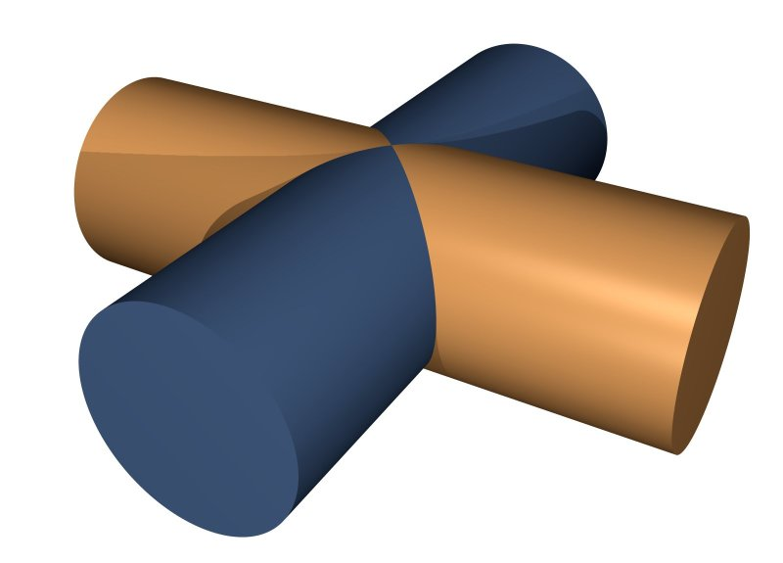

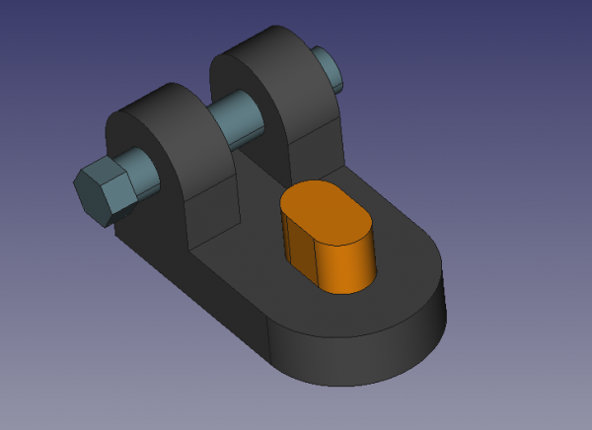
Intersection of Solids
Why is it important?
We will deal with intersection of:
  Solid with Line
  Solid with Plane
  Solid with Solid
https://www.google.com/search?biw=1517&bih=730&tbm=isch&sa=1&ei=0wS3XfPlAoqvyAPZuq_AAg&q=vintage+motor+bike+enfield+pictures&oq=vintage+motor+bike+enfield+pictures&gs_l=img.3...74753.77911..78573...0.0..0.181.1273.0j8......0....1..gws-wiz-img.ferhoRzcsiI&ved=0ahUKEwizm_Wqnr_lAhWKF3IKHVndCygQ4dUDCAc&uact=5#imgrc=8d-ADTqVD5VF0M:

Slide 4
Review: Cutting Plane Method
C_{H}
Q_{H}
Y_{H}
POI should be on X_{H}-Y_{H}
Project the line X_{H}-Y_{H} in the FV
Look for POI between the projection of PQ and XY on FV
Check for visibility
D_{H}
O_{H}
X_{H}
B_{H}
P_{H}
A_{H}
H
F
Q_{F}
D_{F}
C_{F}
X_{F}
O_{F}
Y_{F}
P_{F}
B_{F}
A_{F}

Slide 5
Intersection of a Line and a Pyramid
2_{H}
Cutting Plane Method
5_{H}
Take a vertical cutting plane passing through 4-5 and cutting the pyramid edges at X, Y, and Z in HV
Z_{H}
Q_{H}
O_{H}
Y_{H}
Locate points X, Y, and Z in FV
P_{H}
1_{H}
The points of intersection of line and pyramid should be located on the cutting plane
X_{H}
3_{H}
4_{H}
H
F
O_{F}
Y_{F}
Find intersection points P and Q in FV; then project PQ in HV
5_{F}
Q_{F}
Visibility?
P_{F}
4_{F}
Note that it is not necessary to show line 4-5 inside the solid
1_{F}
X_{F}
2_{F}
Z_{F}
3_{F}

Slide 6
Intersection of Line and Cylinder
Cutting Plane Method
Given a line and a cylinder, find the points of intersection:
Pass a plane parallel to cylinder axis and containing the line AB
Locate the points of intersection of the ‘cutting plane’ and ‘base’/‘top’ of the cylinder (i.e., P, Q, R, and S)
One of the ‘point of intersection’ between line and cylinder is the intersection of PR and AB in FV (i.e. X_{F})
Another ‘point of intersection’ is the intersection of QS and AB in FV (i.e. Y_{F})
Points of intersection X_{F} and Y_{F} are projected in HV
Find visibility and complete the drawing
Q_{H}
B_{H}
Y_{H}
P_{H}
X_{H}
A_{H}
P_{F}
Q_{F}
B_{F}
Y_{F}
X_{F}
A_{F}
R_{F}
S_{F}

Slide 7
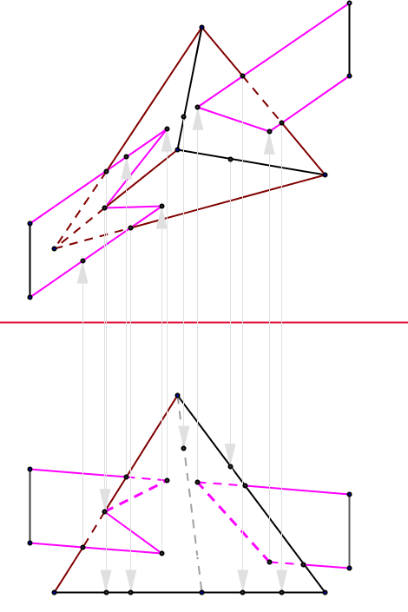
Intersection of a Plane and a Pyramid
A_{h}
Q_{h}
Cutting Plane Method
Visibility needs to be found for:
Path of intersection
Plane and solid
1_{h}
4_{h}
S_{h}
O_{h}
5_{h}
3_{h}
C_{h}
P_{h}
2_{h}
B_{h}
R_{h}
H
F
O_{v}
P_{v}
1_{v}
4_{v}
3_{v}
Q_{v}
R_{v}
2_{v}
5_{v}
S_{v}
Complete Solution
B_{v}
A_{v}
C_{v}

Slide 8
Thank You !!!

